Slide 1
Sustainable AMS Software Development A C++ waveform parser with bindings for several languages
Kleinmeier Benedikt
December 20, 2021

Slide 2




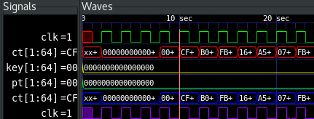
Context
Motivation: Many EDA tools with a plethora of different output formats (FSDB, HDF5, PSF, Scope, ...)
Goal: Parser for different waveform files:
Supported formats: FSDB, HDF5, PSF and Scope
Only support binary data
API:
getSignalNames()
getSignalUnits()
getSignals(<optionalSignalList>)
Optional name translation to/from SPICE
Interfaces to scripting languages by using SWIG

Slide 3
Example usage for C++ (see also live demo)
1
auto parser = ScopeParser("test_file.tr.p1");
parser.getSignalNames();
// Returns:
X1/XSUB/DUMMY
...
2
auto parser = ScopeParser("test_file.tr.p1");
parser.getSignals()
// Returns:
Data in row 0:
0 0 0 0 0 0 0 0 0 0 0 0 0 0 0 0 0 0 0 0
Data in row 1:
1e-11 9.27613e-10 2.33455e-13 ...
Note: getSignals() returns (x,y) or (x,y,z) tuples for each signal!
3
auto parser = ScopeParser("test_file.tr.p1");
parser.getSignals({“X1/XSUB/DUMMY“})
// Returns:
Data in row 0:
0 0
Data in row 1:
1e-11 9.27613e-10

Slide 4
Current status
Finished:
Parser library is fully implemented in C++ 17
with unit tests
and CI/CD setup
Working Perl and Python bindings
Urgent TODOs (see also TODO.md in repo):
GUI integration
Performance improvement in PSF code:
Replace naive “v.push_back(data)” approach by pre-allocating memory, i.e. “v = vector(pre_calculated_size) ... v[i] = data”
…

Slide 5
Backup slides

Slide 6



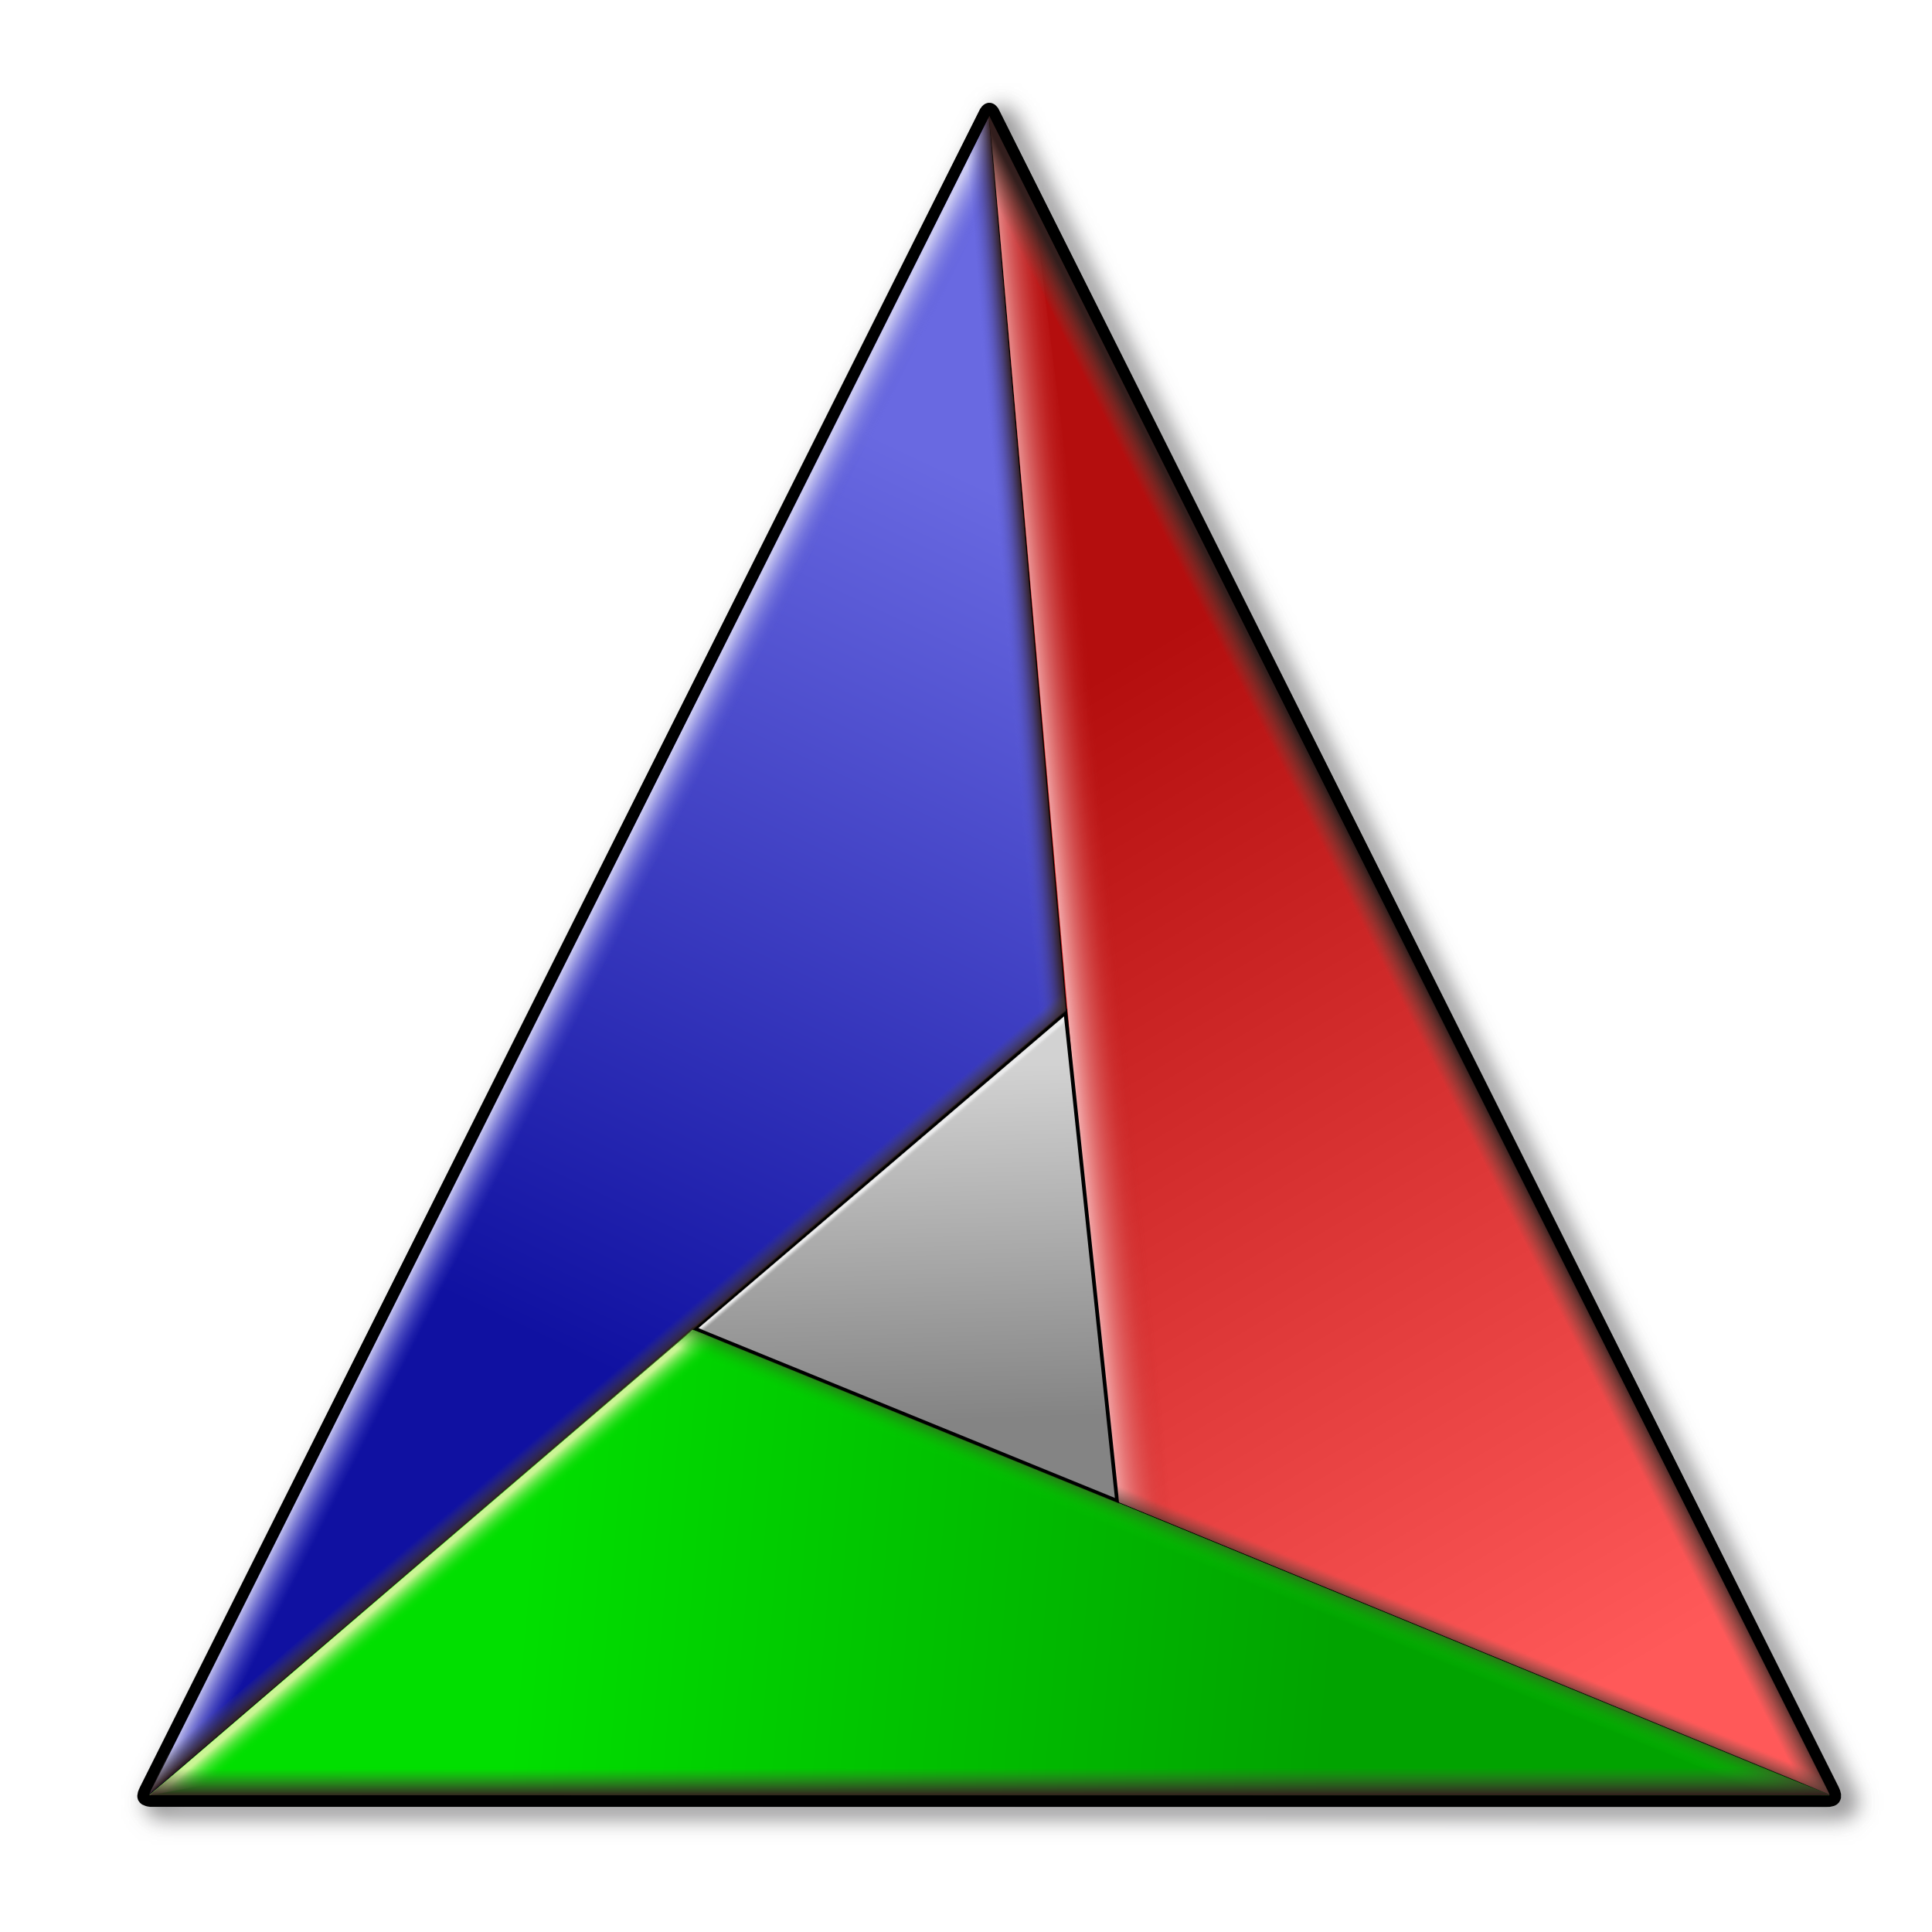


Used tools (as reference for other projects)
IDE: Eclipse 2021-06
Build tools:
CMake 3.14
GNU make
GCC 8.2.0
Unit tests: Catch2 framework plus code coverage with Lcov
CI/CD
Jenkins: https://jenkins.acme.com/job/Waveform%20Parser/
SonarQube: https://sonar.acme.com/dashboard?id=CI-WaveformParser

Slide 7
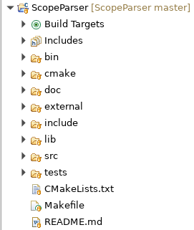
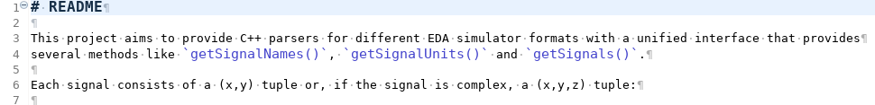
Directory structure

Slide 8
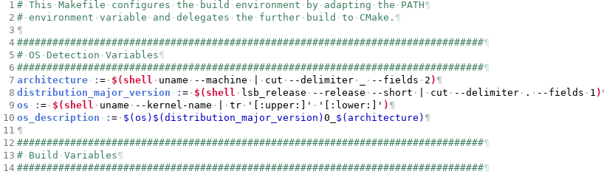
Build system: CMake and a Makefile wrapper

Slide 9
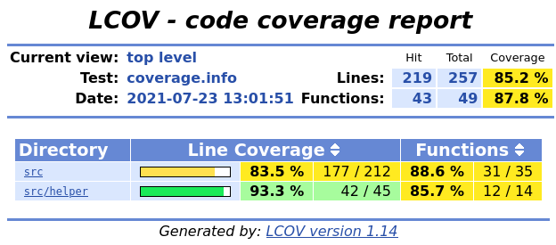
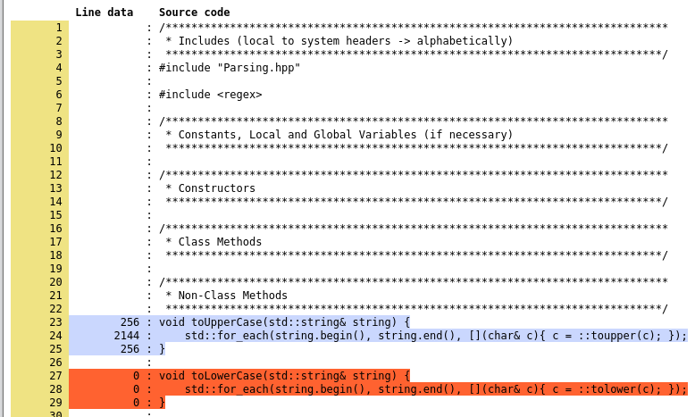
Unit tests and code coverage

Slide 10
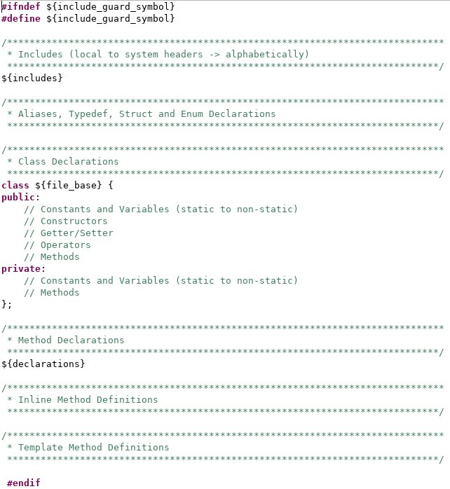
Uniform file structure
1
2
3
4
5
6

Slide 11
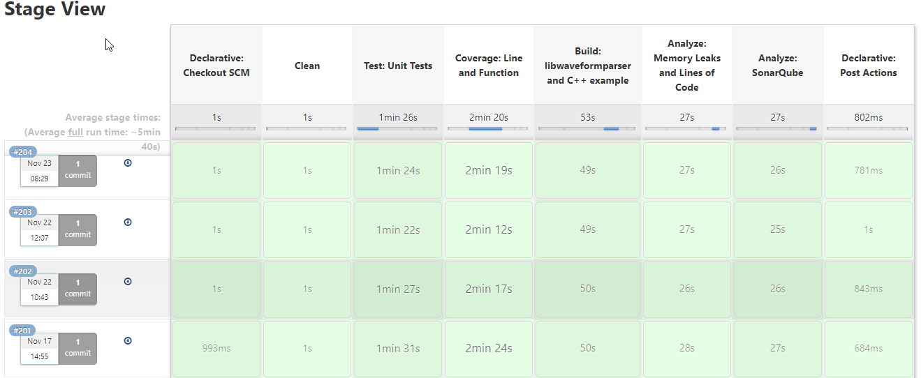
Continuous integration

Slide 12
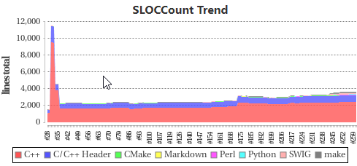
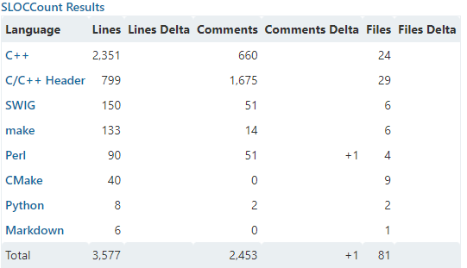
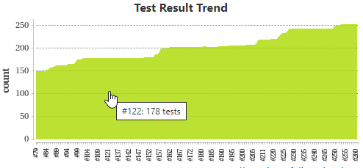
Some metrics
Size of libwaveformparser.so: 3.2 MiB
Lines of code: ~3.5k (new C++) vs. ~11.5k (old C++ code)
Code coverage:
Lines: 92.2% (1480 of 1605)
Functions: 94.1% (206 of 219)

Slide 13
Git tags (git tag -n)
Name | Comment
0.1 | First working version which can read binary Scope files and which reads all signals in a buffered fashion row-wise
0.2 | Replace row-wise and buffered reading by "use seekg()" to extract only certain signals
0.3 | Extract signals as (x,y,z) tuple instead of (y,z) tuple, where
0.4 | First working version of FSDB parser which relies on Synopsis' low-level API
0.5 | First working version of PSF parser which relies on the low-level API under "external/psf"
0.6 | First working version of HDF5 parser which relies on the pre-installed HDF5 library
0.7 | First working version of fully functional Perl bindings which are generated with SWIG
0.8 | First working version of fully functional Python bindings which are generated with SWIG

Slide 14
Resources
Icons:
https://www.gnu.org/graphics/empowered-by-gnu.svg
https://commons.wikimedia.org/
Git repo: https://bitbucket.acme.com/projects/waveformparser/browse
Jenkins: https://jenkins.acme.com/job/Waveform%20Parser/
SonarQube: https://sonar.acme.com/dashboard?id=CI-WaveformParser

